Slide 1
Nerve Pathways

Slide 2
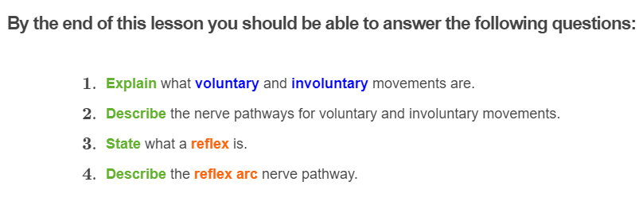
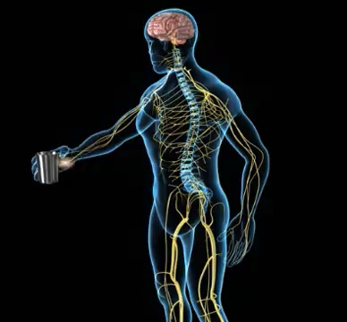

Slide 3
Have you noticed that some movements you make are under your conscious control, like when you are moving your legs to take a walk?
What about movements that you don't think about, like the beat of your heart? Or when you instinctively move your hand off a hot stove?
These are examples of a reflex, and a voluntary and involuntary movement. Keep reading to find out which is which!

Slide 4
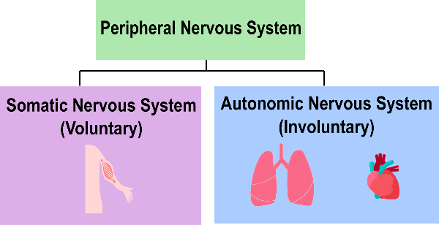
The peripheral nervous system is divided into the somatic and autonomic nervous system.
The somatic nervous system is involved in controlling voluntary movement, whereas the autonomic nervous system is responsible for involuntary functions.

Slide 5
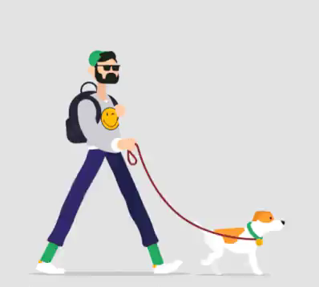
Let's first take a look at voluntary movements.
Voluntary movements are actions that you make your body do. For example, when you decide go for a walk, you make your legs move. Your legs don't just start moving without you wanting them to! They are movements that the body does consciously.
You could easily stop these movements if you wanted to.

Slide 6
The somatic nervous system is responsible for all voluntary movements, and collects information through the sensory organs such as the eyes, ears and mouth.
This information is then processed by the brain and a response is made.

Slide 7
To produce all movements, electrical impulses (nerve impulses) have to travel across a specific pathway in order to produce a response.
The pathway that the nerve impulse takes (or the journey if you like), is known as the nerve pathway.

Slide 8
Let's first take a look at the nerve pathway during voluntary movements.
1. Stimuli from the environment is sensed by sensory receptors in the sensory organs (skin, tongue, eyes, ears or nose).

Slide 9
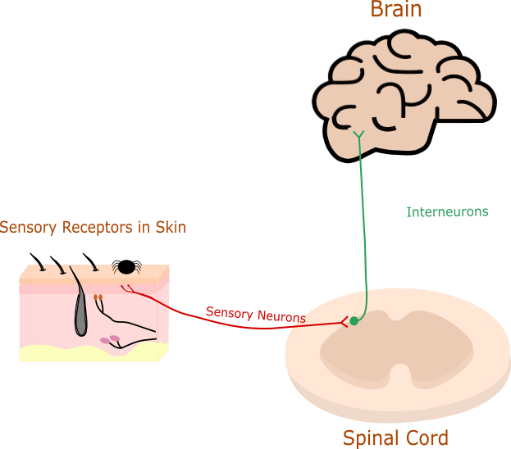
2. This causes an electrical impulse to be sent through sensory neurons to the spinal cord and up to the brain, where the information is processed.

Slide 10
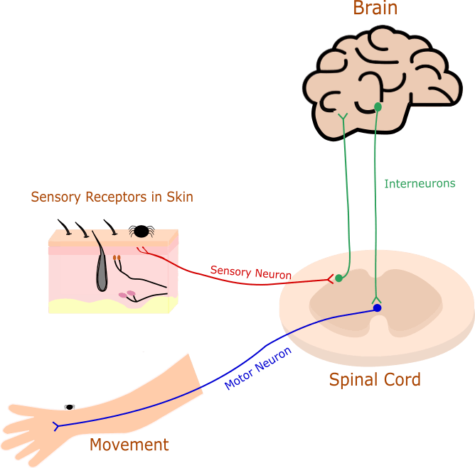
3. The brain processes these signals and makes a decision on how to respond to the stimulus.
4. An electrical impulse is then sent along the interneurons in the brain and spinal cord which relays the information down to the motor neurons and takes the electrical impulse to the muscles, resulting in a movement, like moving the hand.

Slide 11
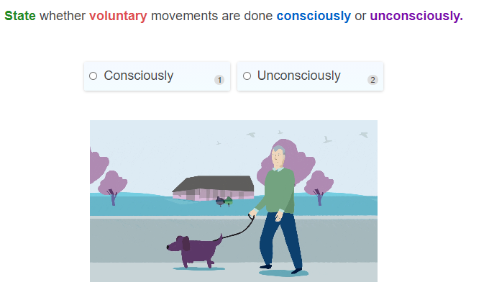

Slide 12
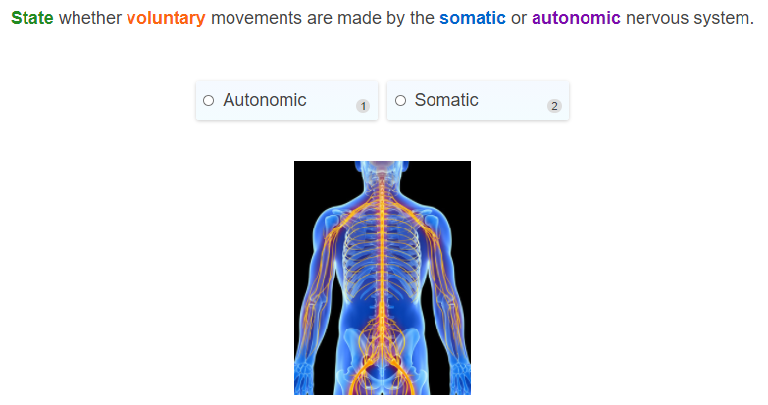

Slide 13
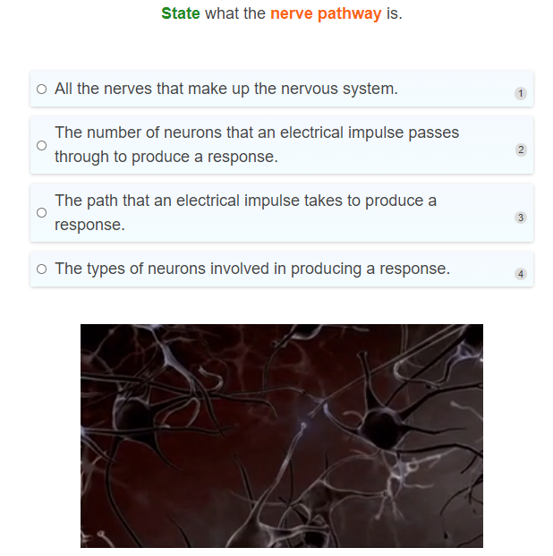

Slide 14
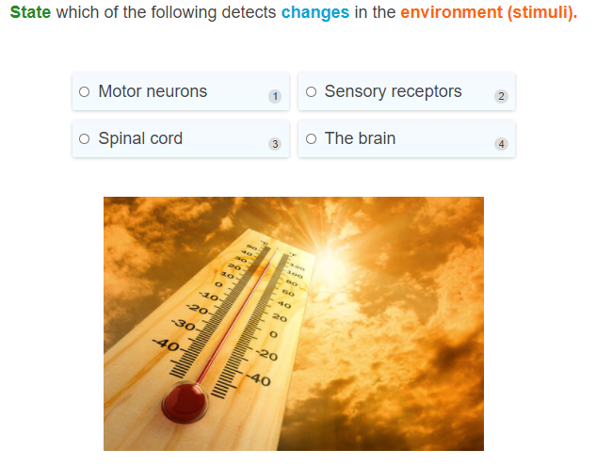

Slide 15
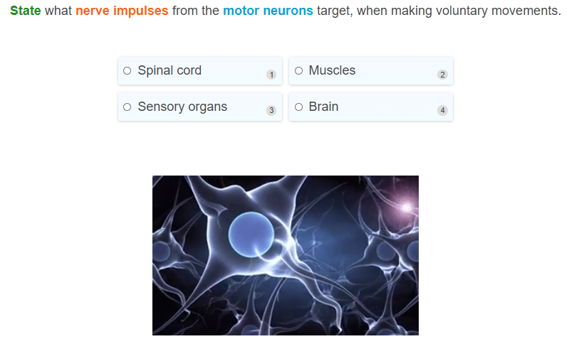

Slide 16

Involuntary movements are movements that your body does without you thinking about them.
Examples of involuntary movements include your heart beating, your lungs breathing and your eyes dilating or constricting.
These are all movements that occur unconsciously and are controlled by the autonomic nervous system.

Slide 17
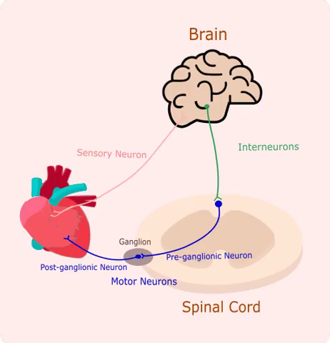
The nerve pathway of involuntary movement is similar to the nerve pathway for voluntary movements.
Let's look at an example of regulating heart rate as an involuntary movement.
1. Imagine that you have an increased heart rate from exercising. This stimulus is sensed by sensory receptors and an electrical impulse is first sent through the sensory neurons.

Slide 18

2. The sensory neurons take the electrical impulse up to the brain where this information is processed, and the brain decides what to do. An electrical impulse is then sent through the interneurons in the brain and along the spinal cord.

Slide 19

3. The interneurons then pass the electrical impulse onto the motor neurons.
There are two types of motor neurons that the electrical impulse passes through in the involuntary nerve pathway, called the pre-ganglionic neuron, and the post-ganglionic neuron. Hopefully you remember this from the previous Smart Lesson!
The electrical impulse is first transmitted through the pre-ganglionic neuron, and then the post-ganglionic neuron.

Slide 20
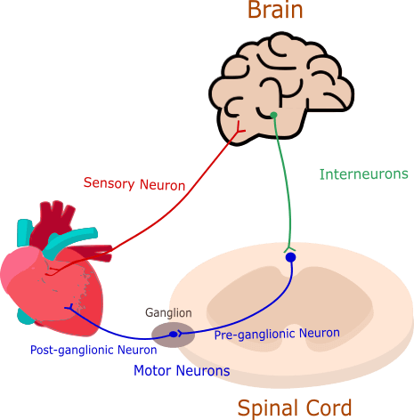
4. The post-ganglionic neuron directly connects to the heart, resulting in a response to lower the heart rate back to normal.

Slide 21
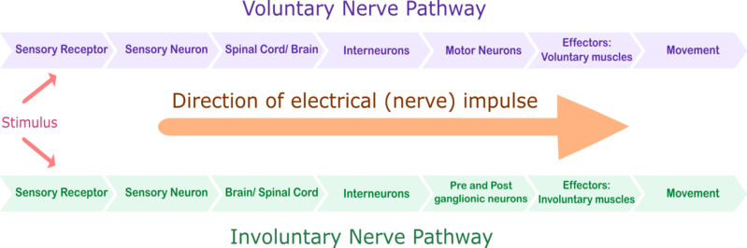
The diagram below summarises the nerve pathway for both voluntary and involuntary nerve pathways.
You might notice that the pathway the electrical impulse travels along is almost the same for both voluntary and involuntary pathways.
The main difference is that in the involuntary nerve pathway, the electrical impulse has to pass through two motor neurons (the pre and post ganglionic neurons) instead of just one in the voluntary pathway.
It is also important to note that the brain is involved in both of these pathways.

Slide 22
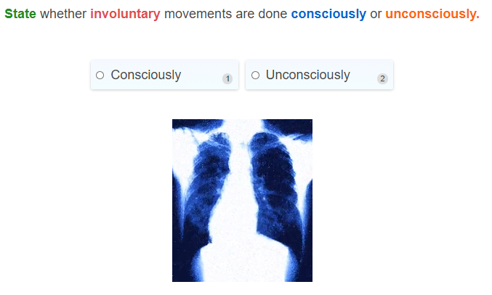

Slide 23
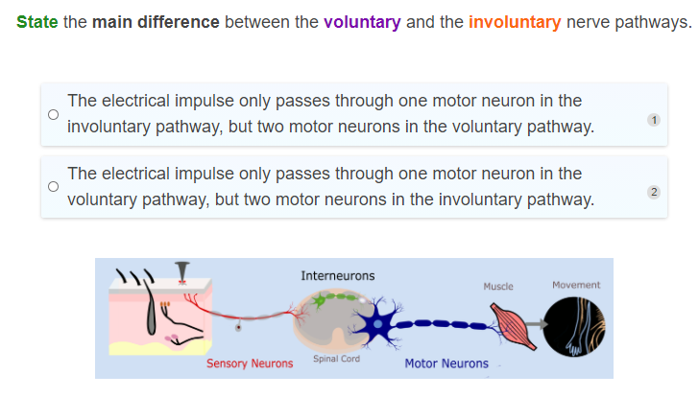

Slide 24
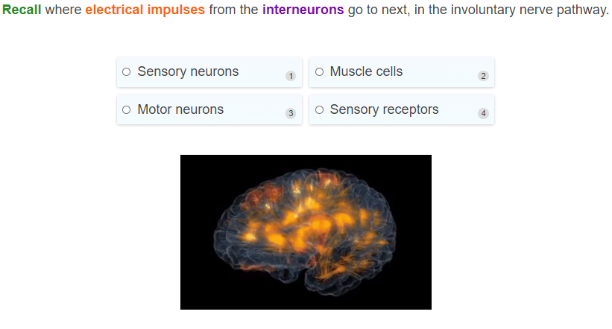

Slide 25
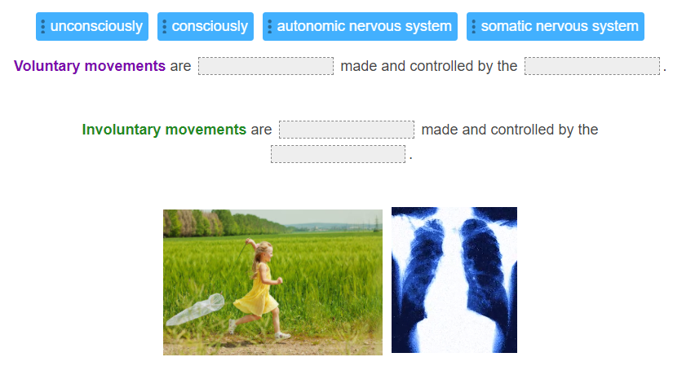

Slide 26
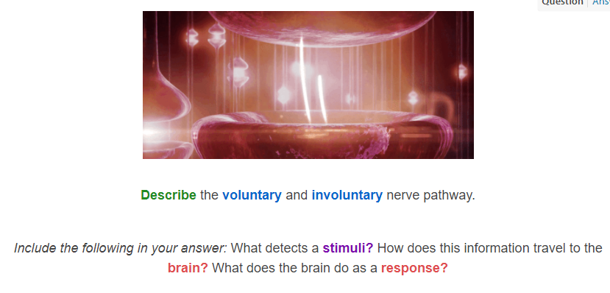

Slide 27
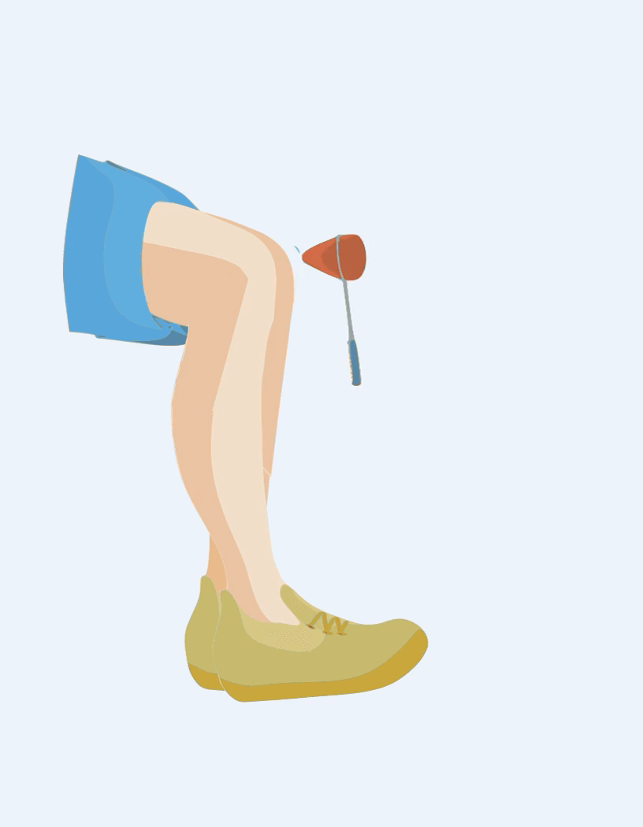
Have you ever wondered why your leg suddenly kicks out when the doctor taps your knee with that little rubber hammer?
This is an example of a reflex action!
Feel free to try this out yourself if you haven't already! Softly tap your leg just below your knee cap while sitting with your legs dangling. Your knee should suddenly swing outwards.

Slide 28

Reflex
So far, we have seen that the nerve pathways for both voluntary and involuntary movements require the brain to process the information before a response is made.
However, sometimes a very quick response can be made without involvement of the brain. This is called a reflex! This is an automatic, unconscious response that your body makes in response to a stimulus, like the knee tap.
For example, sneezing and coughing are examples of some of your body's reflexes. They clear your airways of irritating things.

Slide 29
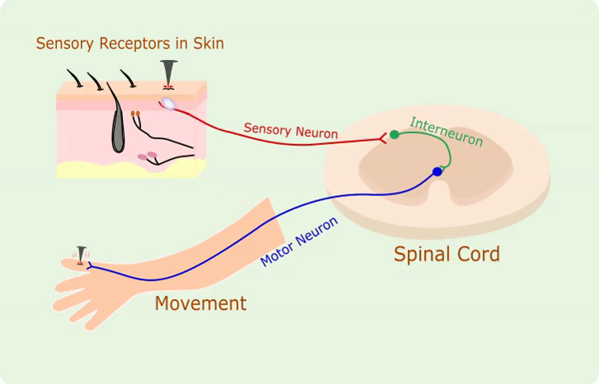
Let's have a look at an example of a reflex.
You may have accidentally pricked yourself with something sharp before, like a nail.
Instinctively, you will move your hand away from the nail. This is the reflex action. Your hand has automatically moved away from that nail before your brain has processed that information.

Slide 30
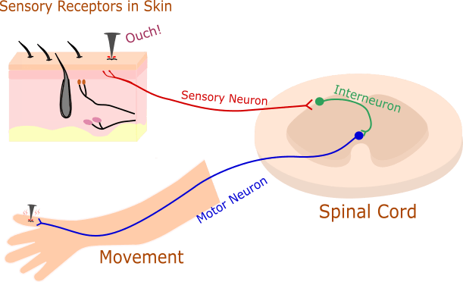
The nerve pathway that causes this reflex action to occur is called the reflex arc.
1. In the reflex arc pathway, the stimulus is detected by sensory receptors. In this example the stimulus is the sharp nail.

Slide 31
2. An electrical impulse is sent through sensory neurons which take this information to the spinal cord.
3. An interneuron in the spinal cord joins the sensory neuron to the motor neuron and the electrical impulse travels along the interneuron and to the motor neuron resulting in a reflex action - your hand moves quickly away from that nail.
This all happens in less than a second, before your brain has even processed what has happened!

Slide 32
The reason why this fast, automatic response is possible is because the reflex arc does not require any input or processing of information from your brain!
This characteristic allows reflex actions to occur relatively quickly by activating motor neurons without the delay of having to go through the brain.

Slide 33
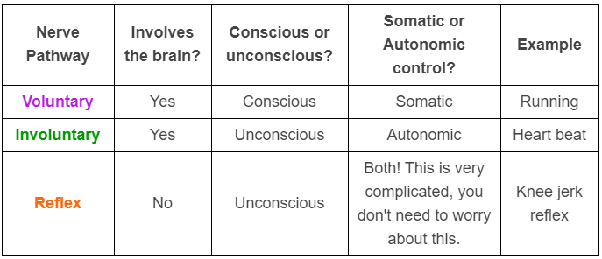
This table summarises some important points of the reflex arc, voluntary, and involuntary nerve pathways.

Slide 34
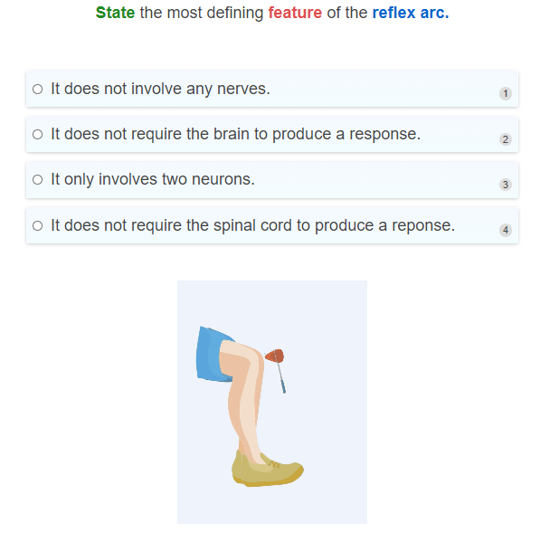

Slide 35
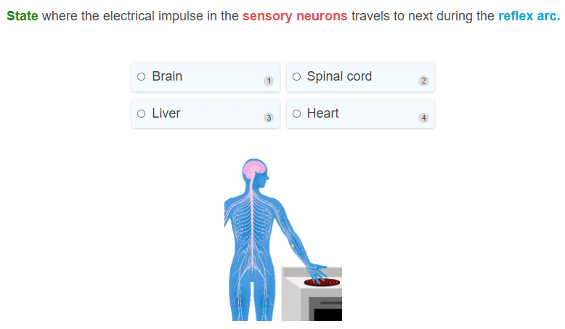

Slide 36
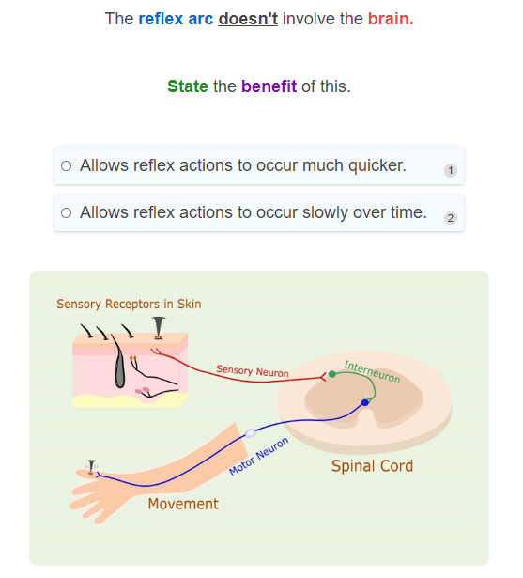

Slide 37
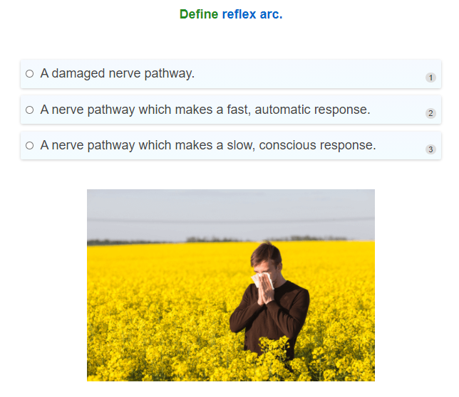

Slide 38
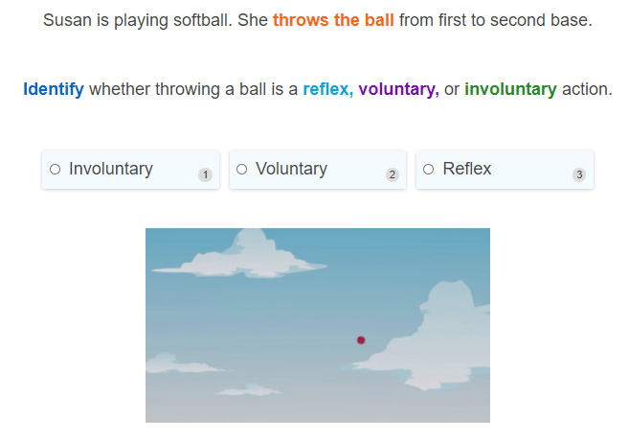

Slide 39
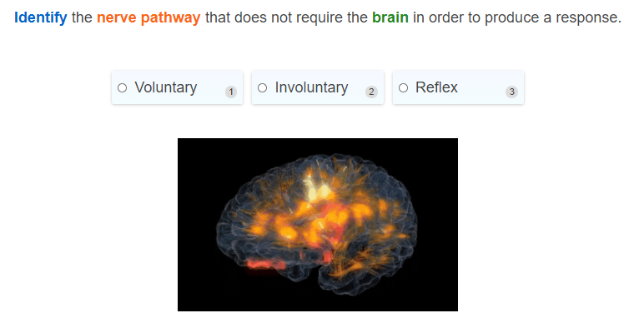

Slide 40
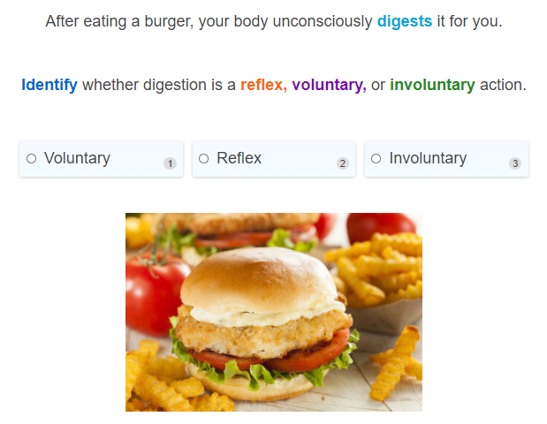

Slide 41
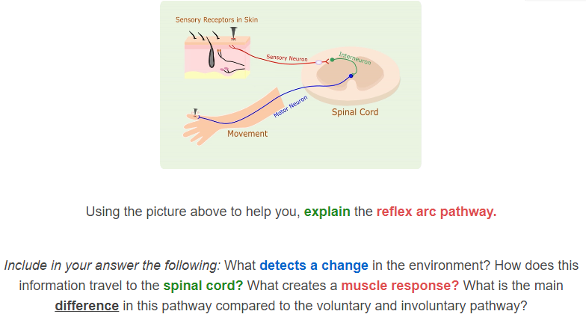

Slide 42
